Slide 1

MICROSOFT COPILOT
An Overview

Slide 2
Topics
Introduction
Description
Capabilities
Privacy and Security
Conclusion

Slide 3
INTRODUCTION
Copilot combines the power of large language models (LLMs) with Microsoft 365 Apps to improve productivity

Slide 4
Copilot versions
Windows 11 Copilot
Bing Chat Enterprise
Microsoft 365 Copilot
Built into the Windows operating system
Free update for Windows 11 users
Sample tasks:
Open applications
Copy and paste
Take screenshots
Built into Microsoft Bing
Free in preview but will cost $5 USD per user per month (as a standalone product)
Sample tasks:
Query the web
Integrated into Microsoft 365 apps
$30 USD per user per month (only for enterprise customers)
Sample tasks:
Summarize documents
Draft emails
Notes:
https://github.com/features/copilot#pricing
https://www.microsoft.com/en-us/microsoft-365/blog/2023/07/18/introducing-bing-chat-enterprise-microsoft-365-copilot-pricing-and-microsoft-sales-copilot/
https://mspoweruser.com/differences-between-microsoft-365-copilot-bing-chat-enterprise-and-copilot-in-windows/

Slide 5
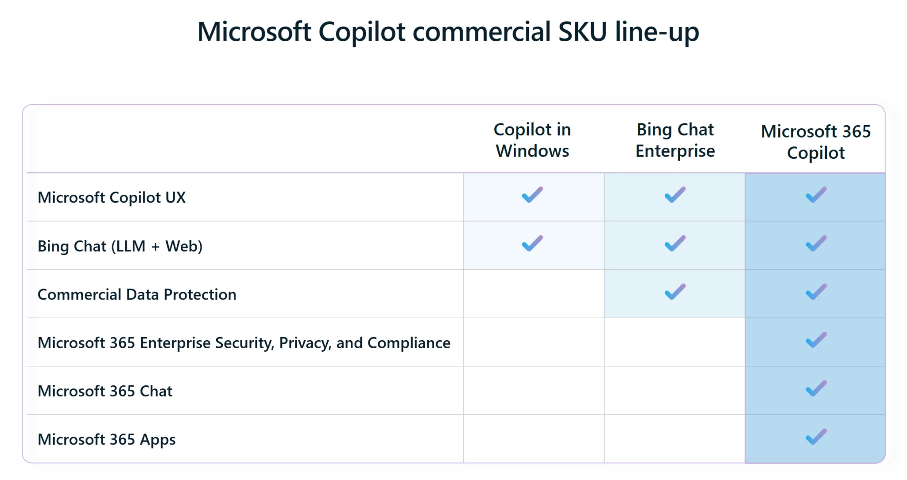
Microsoft copilot

Slide 6
implementation
Technical Requirements
Have either Microsoft 365 E3 or E5 license
Have an Azure Active Directory account
Permissions and Content Management
Share content with only the needed audience (avoid oversharing)
Implement good data governance practices
Notes:
https://techcommunity.microsoft.com/t5/microsoft-365-copilot/how-to-prepare-for-microsoft-365-copilot/ba-p/3851566

Slide 7
Description
What is it? How does it work?
Notes:
Next, we’ll go through a description of what Copilot is, and how it works.

Slide 8
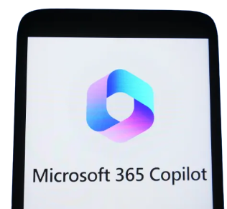
What is copilot?
Copilot is an AI assistant for Microsoft 365 applications and services:
Works across apps to incorporate relevant data into helpful results
Tool to help automate day-to-day tasks
Marketed with a focus on increasing productivity
Notes:
Copilot is an AI assistant that will span across all of Microsoft 365 applications and services.
It works across these apps to incorporate context and relevant data into more helpful results
It is shown as a tool that can help people automate many of their day-to-day tasks (like creating documents and presentations, reading and summarizing emails, meeting transcripts, analyzing data in Excel, and more).
It’s marketed with a focus on productivity for its users
References: 1. Microsoft announces Copilot: the AI-powered future of Office documents - The Verge
2. What is Microsoft Copilot? Here's everything you need to know | ZDNET

Slide 9

How does it work?
Combines LLM with data generated by applications
Incorporates Microsoft Graph (an API platform) to modify user inputs and improve outputs from LLM
Notes:
Next we’ll go through how Copilot works. Here, we’ve included a video from Microsoft to better visualize the process, but as a brief overview:
Copilot combines the power of LLMs with enterprise data generated by applications to provide context for prompts
To do this, it incorporates Microsoft Graph, which is an API platform that provides access to this enterprise data, to modify user inputs and improve outputs from the LLM
This gives Copilot a view across your applications, the web, and even multiple devices.
The Copilot System: Explained by Microsoft – YouTube Business chat -> Introducing Microsoft 365 Copilot – your copilot for work - The Official Microsoft Blog

Slide 10
capabilities
Notes:
Next, we’ll go through the capabilities of Copilot.
Microsoft Copilot
Announcing Microsoft Copilot, your everyday AI companion - The Official Microsoft Blog

Slide 11
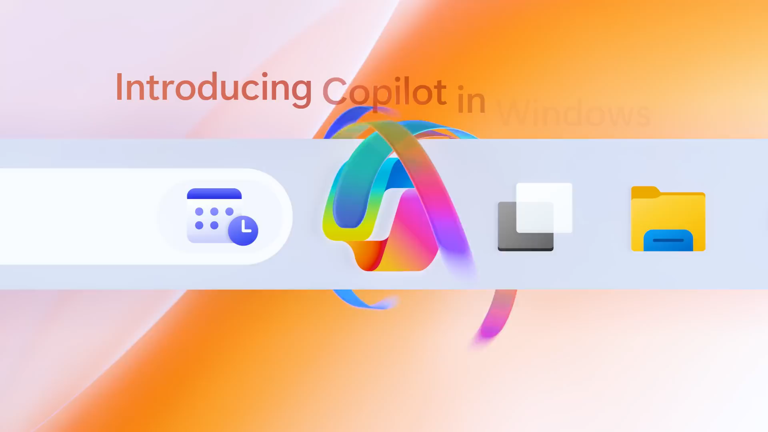
In windows 11
Notes:
First, we’ll show what Copilot can do in Windows 11, this is the version of Copilot that was recently released as part of an update and built into the operating system.
After video:
As you can see it acts as a taskbar, can help you perform various tasks across your device such as playing music, adjusting system settings or even organizing your windows. It also lets you copy and paste images to be edited, summarize web pages, and search the web.

Slide 12

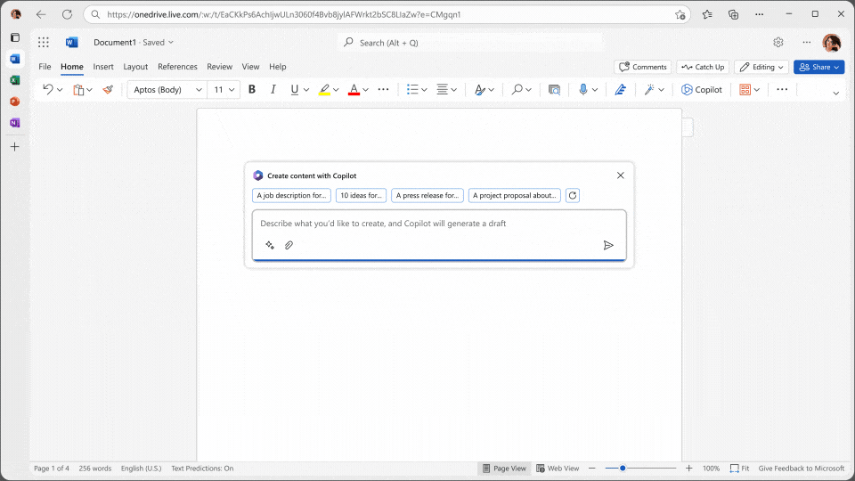
Word
Uses:
Generate documents, with the ability to include up to 3 files as reference
Provide a summary of documents
Provide answers to questions based on the content
Find additional details from web to add to document
Notes:
In Word, one of the main functionalities of Copilot is the ability to generate documents from scratch, with the option to include up to 3 files as reference material. This allows you to easily create drafts or outlines within minutes. Based on the context of the document, Copilot can also generate additional content or provide a summary. It can also provide answers to questions based on the content or search the web to find additional details to enhance your document. Similarly to Bing Chat, to ensure the credibility of information Copilot provides you, the chat interface provides links to references so users may more easily fact check.
Microsoft 365 Copilot in Word

Slide 13

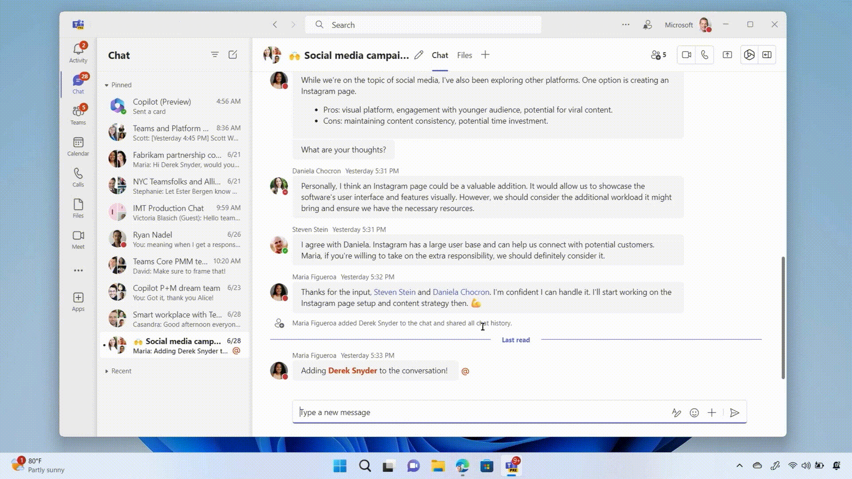
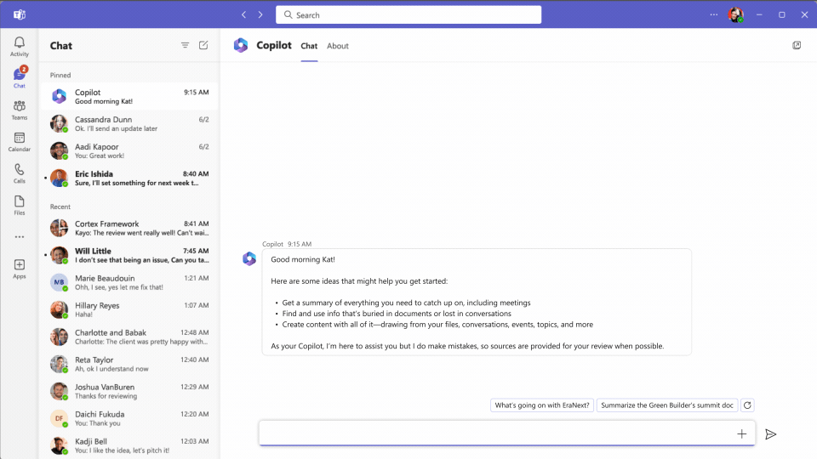
Teams
Chats:
Summarize chat messages
Query answers based on chat history
Meetings:
Query answers at any time during or after a recorded or transcribed meeting
Generate meeting notes and action items
Give answers to various questions, list main ideas discussed
Notes:
Next, on Teams, Copilot can summarize chat messages or query answers based on chat history.
In meetings, Copilot can:
Query answers at any time during or after a recorded or transcribed meeting
Generate meeting notes and action items
Give answers to various questions, such as listing the main ideas discussed

Slide 14

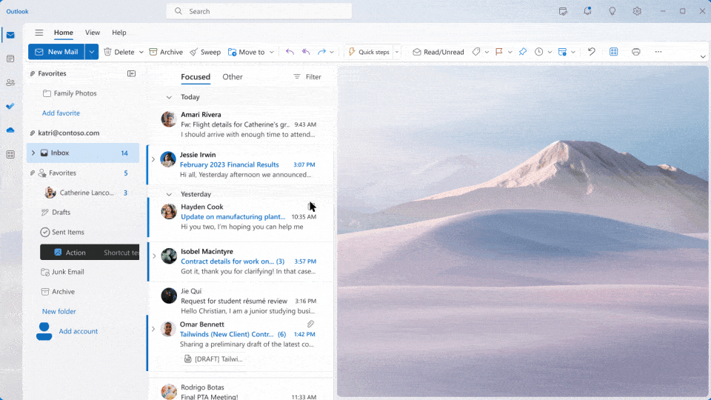
Outlook
Summarize:
Summarize email threads, pulling out key points from multiple messages
See what decisions have been made and what actions have been suggested
Draft:
Takes a user prompt and generate a full-length email
User can change the prompt or tone/length settings
Reply to a message using the context of that thread
Notes:
In Outlook, Copilot can:
Summarize email threads, pulling out key points from multiple messages
See what decisions have been made and what actions have been suggested
When creating a draft email, it can:
Take a user prompt and generate a full-length email
With the user being able to change the prompt or tone/length settings
Reply to a message using the context of that thread

Slide 15

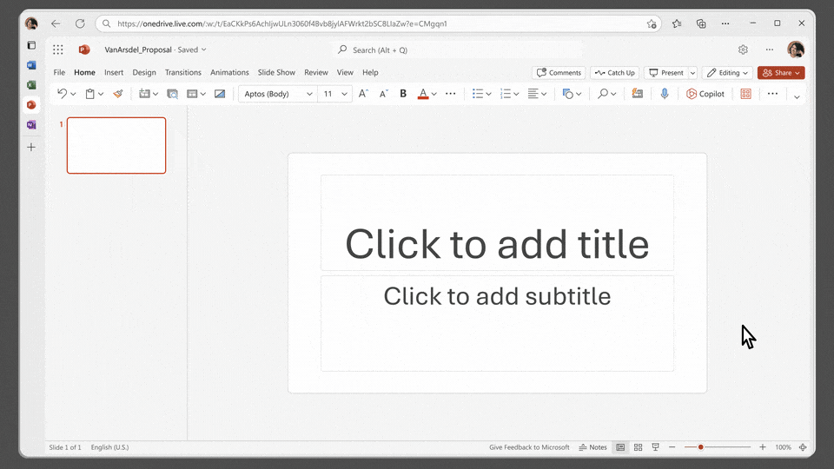
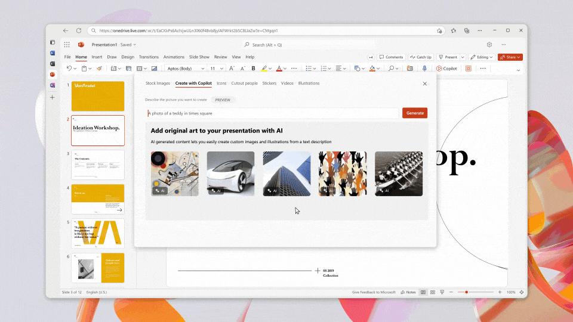
Powerpoint
Uses:
Create a draft presentation
Summarize key points of a presentation
Restructure slides
Generate slides and images
Ask and answer different questions in relation to presentation contents
Notes:
In PowerPoint, Copilot can:
Create a draft presentation
Summarize key points of a presentation
Restructure slides
(This is a really cool feature, it can) Generate slides and images (using the DALL-E 3 model)
Ask and answer different questions in relation to presentation contents

Slide 16

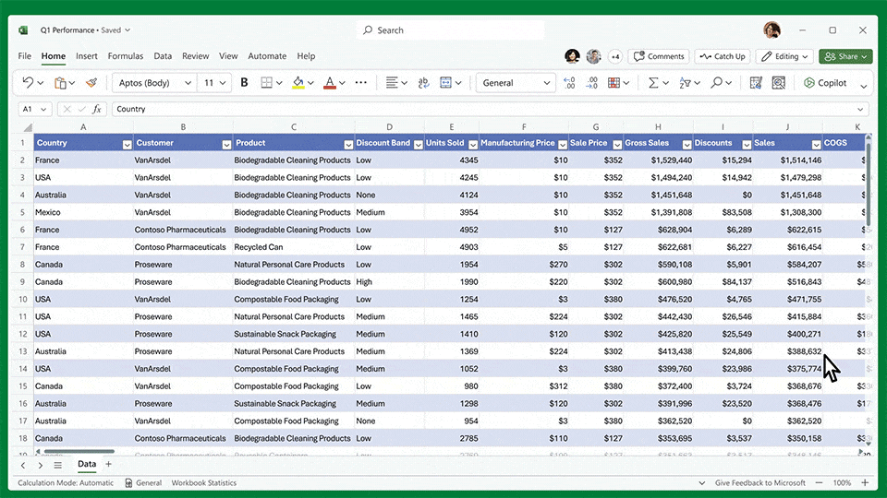
excel
Uses:
Explore and analyze data
Identify and visualize trends
Offer recommendations to drive different outcomes based on the data
Generate formulas
Format data
Create graphs
Notes:
Copilot also has a lot of uses within Excel. It allows you to easily:
Explore and analyze data
Identify and visualize trends
Offer recommendations to drive different outcomes based on the data
Generate formulas
Format data
Create graphs

Slide 17

Power BI
Uses:
Create visuals and insights through a prompt
Generate and edit DAX queries
Create narrative summaries
Ask questions about data
Tailor the tone, scope and style of narratives
Text summaries
Notes:
Similarly to Excel, Copilot also has a lot of functionality in Power BI. It can:
Create visuals and insights through a prompt
Generate and edit DAX queries
Create narrative summaries
Ask questions about data
Tailor the tone, scope and style of narratives
Generate text summaries
Introducing Microsoft Fabric and Copilot in Microsoft Power BI | Microsoft Power BI Blog | Microsoft Power BI

Slide 18
365 chat/Business chat
Available in:
Copilot app for Teams
Microsoft Bing
Microsoft365.com
Uses:
Summarize large amounts of data
Brainstorm ideas and draft new content
Personal search engine for files and messages
Notes:
Microsoft 365 Chat, otherwise known as Business Chat is a new feature that has been introduced alongside Copilot. So how does this differ from the other forms of Copilot that we’ve seen so far? Copilot in Microsoft 365 Apps (such as Word or PowerPoint) is specifically orchestrated to help you within that app. On the other hand, Microsoft 365 Chat works across multiple apps and content. Its ability to work using multiple sources at once allows you to tackle broader projects and activities.
Currently, it’s available in:
Copilot app for Teams
Microsoft Bing
Microsoft365.com
Some of its uses include:
Summarize large amounts of data
Brainstorm ideas and draft new content
Personal search engine for files and messages
Get started with Microsoft 365 Chat in Microsoft Teams - Microsoft Support
Overview of Microsoft 365 Chat (preview) - Microsoft Support
Introducing Microsoft 365 Copilot | Microsoft 365 Blog (<- shows Business Chat is the same as 365 chat)

Slide 19
Copilot versus chatgpt
How do they match up?
Notes:
GPT-4 (openai.com)

Slide 20
comparison
Microsoft 365 Copilot
ChatGPT
Digital assistant
Can access data contained in emails, documents, etc.
Understands context based on information from Microsoft Graph
Uses private instances of OpenAI LLMs (GPT-4 and DALL-E 3)
Chatbot
Cannot access personal or organizational data
Can only understand context if that information is provided in the prompt
Uses public instances of OpenAI LLMs
Notes:
Note: Copilot provides references to sources, whereas ChatGPT doesn’t unless prompted to do so.
https://support.microsoft.com/en-us/topic/chatgpt-vs-microsoft-365-copilot-what-s-the-difference-8fdec864-72b1-46e1-afcb-8c12280d712f
Introducing GPT-4 in Azure OpenAI Service | Azure Blog | Microsoft Azure

Slide 21
Privacy & Security
How data and information is safeguarded

Slide 22
Data
Copilot can only access data that the user has at least view access to
Prompts, responses, and accessed data are not used to train the LLMs
Information contained within prompts, retrieved data, and generated responses stay within the Microsoft 365 service boundary
Notes:
https://learn.microsoft.com/en-us/DeployOffice/privacy/microsoft-365-copilot

Slide 23
copyright
‘Microsoft Copilot Copyright Commitment’ is instated to:
Cover 3rd party IP claims based on copyright, patent, trademark, etc.
Cover customer’s use and distribution of output generated by Copilot
Require the customer to use content filters and other safety systems built into the product
Notes:
https://www.microsoft.com/en-us/licensing/news/Microsoft-Copilot-Copyright-Commitment
https://learn.microsoft.com/en-us/DeployOffice/privacy/microsoft-365-copilot

Slide 24
Server locations
Calls to the LLM are routed to the closest data centre in the region
In times of high utilization, Copilot might call into other regions where capacity is available
No customer data is written outside the user’s home region
Notes:
https://learn.microsoft.com/en-us/DeployOffice/privacy/microsoft-365-copilot

Slide 25
Risks & concerns
Ethics:
Copilot output may not be original
Users may abuse Copilot to do their responsibilities
Reliability:
Copilot cannot help with tasks for which it has no information
Copilot may build responses on information that is not accurate or complete (ex. Brainstorming documents)
Notes:
Good = complete, unbiased, correct, not corrupt
Is the content produced original?
Sometimes its results will be very similar to existing internet content.
Ethical concerns that biases may be reinforced

Slide 26
Conclusion
So, what do we recommend?

Slide 27
Recommendation
Copilot is a great resource to improve productivity and focus on work that is most important.

Slide 28
Appendix

Slide 29
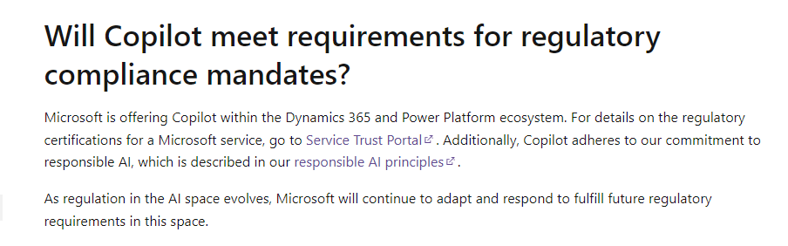
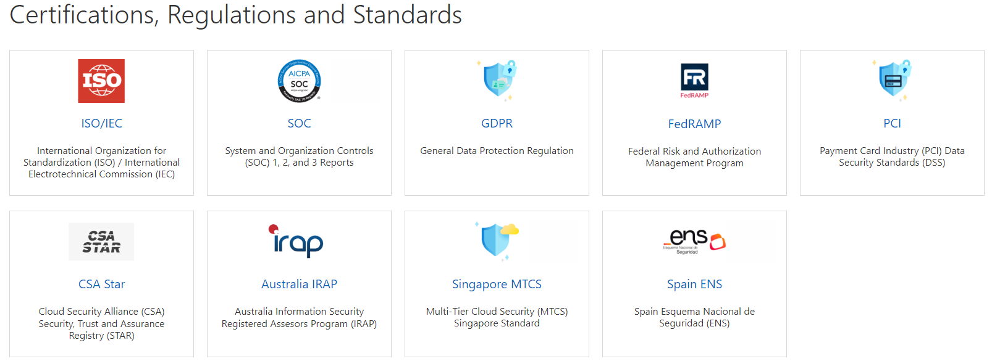
Regulatory compliance

Slide 30
EU Data boundary
Geographically defined boundary that Microsoft has committed to store and process customer data
EU traffic remains within EU Data Boundary, but worldwide traffic can be sent to the EU for LLM processing
Notes:
https://learn.microsoft.com/en-us/privacy/eudb/eu-data-boundary-learn

Slide 31




copilot timeline
Jun. 2021
Feb. 2023
Mar. 16, 2023
Sept. 26, 2023
Nov. 1, 2023
GitHub Copilot is released
Copilot is integrated into Bing Chat
Microsoft 365 Copilot is introduced and begins testing with 20 users
Windows Copilot is released as part of free update to Windows 11
Microsoft 365 Copilot is released for enterprise customers
Notes:
https://www.agileit.com/what-is-microsoft-copilot/
https://blogs.microsoft.com/blog/2023/09/21/announcing-microsoft-copilot-your-everyday-ai-companion/

Slide 32
Models copilot uses
Private instances of OpenAI’s GPT-4 and DALL-E 3 models
Multimodal LLM that can accept image and text inputs and produce text outputs
Text-to-image model that can generate digital images from prompts
GPT-4
DALL-E 3
Notes:
Copilot’s LLMs are hosted in the Microsoft Cloud via the Azure OpenAI Service. However, instead of calling the public OpenAI service that powers Chat GPT, it uses its own private instances of the LLM.

Slide 33
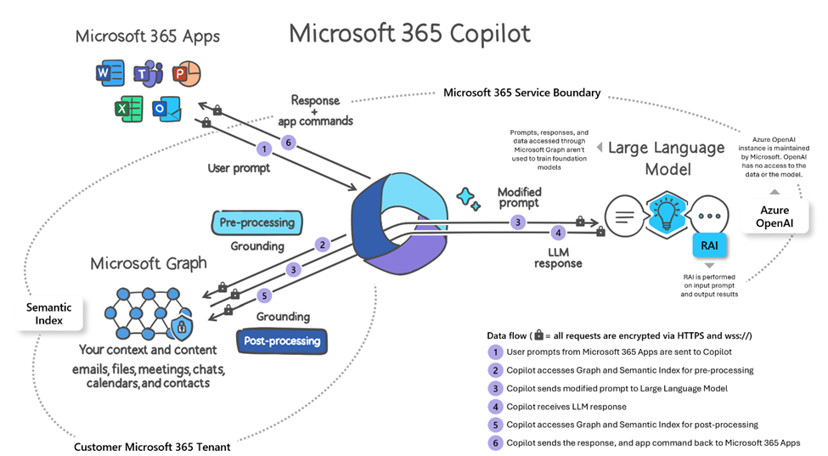
process

